Slide 1
ABOUT THE COMPANY
BHARAT BROTHERS OVERSEAS
Established in 2020. It is a manufacturing unit, situated at
HARIDWAR ROAD AGHWANPUR NEAR PAPER MILL MORADABAD – (U.P.) INDIA.
Manufactures a wide range of products in
in Home Decor, lighting, Kitchen & Table wares , Garden Accessories, Barware, Furniture. and different Indian Handicraft Items of Brass, Aluminum & Iron Art wares. Our products are in regular demand because these attracts to customers due to economical prices and fine quality.

Slide 2
PRODUCTS
Home Decor 30%
Lightening 10%
Furniture 5%
Kitchen 20%
Table wares 25%
Garden Accessories 10%

Slide 3
QUALITY OBJECTIVES
Improve Customer satisfaction level.
To meet on-time every time delivery schedule by 90 %.
Reduce the break down by 5 %.
To reduce rejection level by 5 % annually.
To meet out/rectify the customer within time frame negotiated/described by customer.

Slide 4
ABOUT ESTABLISHMENT
is a unit based in Moradabad some 12 KM West of Moradabad in India. We are into furniture, lighting, and home decor products with specialization in metal and wood products. We have our works equipped with necessary manufacturing and finishing processes giving us advantage in terms of pricing, quality and time. Founded in 1994 in a small space of 2000 sq. feet today we have grown manifold to currently working in over 50000 sq. ft. area and expansion work in progress.
In house manufacturing of Wrought Iron & sheet metal items.
Factory cleared ISO 9000 in 20121.
Annual Turnover : US $ Million …….1 million (approx.)
Short Lead time : 30 - 45 days (depending on the order)
Experienced and dedicated workforce.
Specialized in furniture & Lighting, kitchen accessory, home decor

Slide 5
INFRASTRUCTURE
In-house production lines for Wrought Iron and Sheet metal items.
Incoming material ware house facility available with spot checking
spot welding unit
Genset unit having two Genset
Two lines of Lacquer coating units.
A line of painting or hand paint unit
Electroplating includes Zinc, Brass, Copper, Nickel, Chrome.
Electrophoretic lacquering .
Buffing section 4 machine
QMS test facility in house
Total Area : 50,000 sq. feet.
Covered Area : 20000 sq. feet.
We doing work as per the iso guideline and committed to good quality and
enhance customer satisfaction .
CCTV camera monitoring for security.
Manpower : 50 contractual.

Slide 6
MARKETS AND CUSTOMERS
MAJOR MARKETS : U.S.A, DENMARK, NETHERLAND, U.K, UAE, QATAR
MAJOR CUSTOMERS : USA: TJMAX, LIFESTIEM BRANDS, COSTCO, KALALOU, ACORN, BENZARA, THE URBAN PORT, HOME DÉCOR FACTORY, VESLA , SARO , ATOMIC , ARDENT HOME DÉCOR, SIGNALS CATALOUGE,
              UAE: BEACON, BRASSLIGHT, CUBE LIGHT.
              QATAR: LUMATRON, BEYOND LIGHTING, TORNADO.
              NETHERLAND : LIFESTYLE, KOOPMAN INTERNATIONAL, PTMD, SUSWOOD, SIMLA HOME DÉCOR,
              USA - VESLA , SARO , ATOMIC , TMC

Slide 7
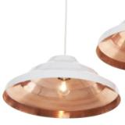
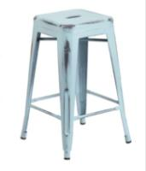
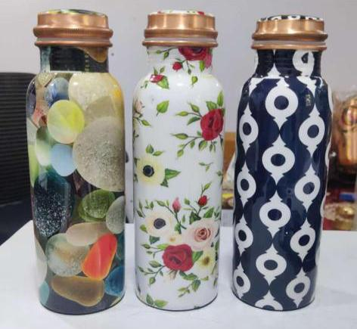
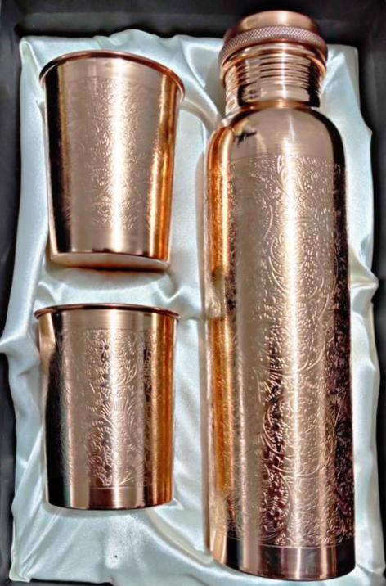
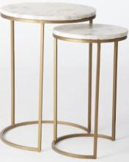
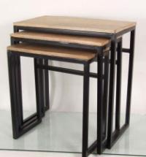
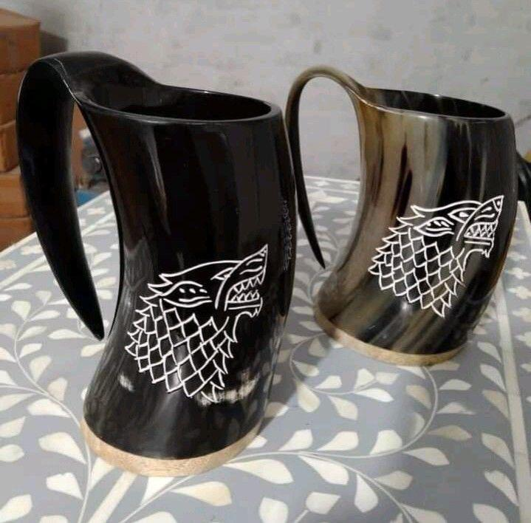
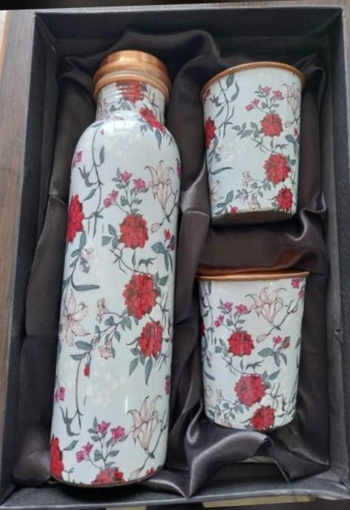
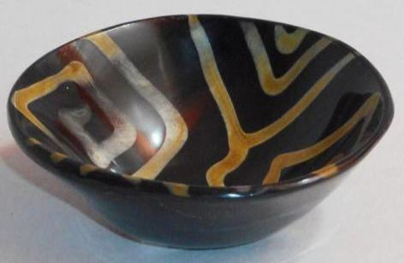
Product Showcase

Slide 8
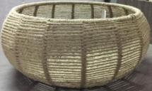
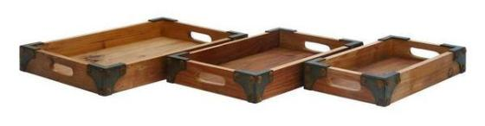
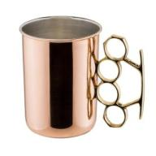
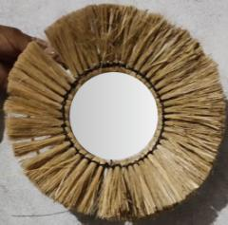
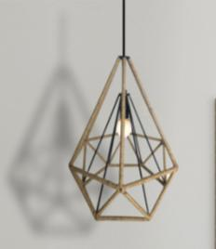
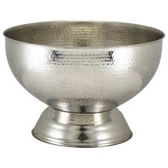
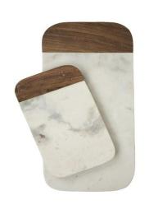
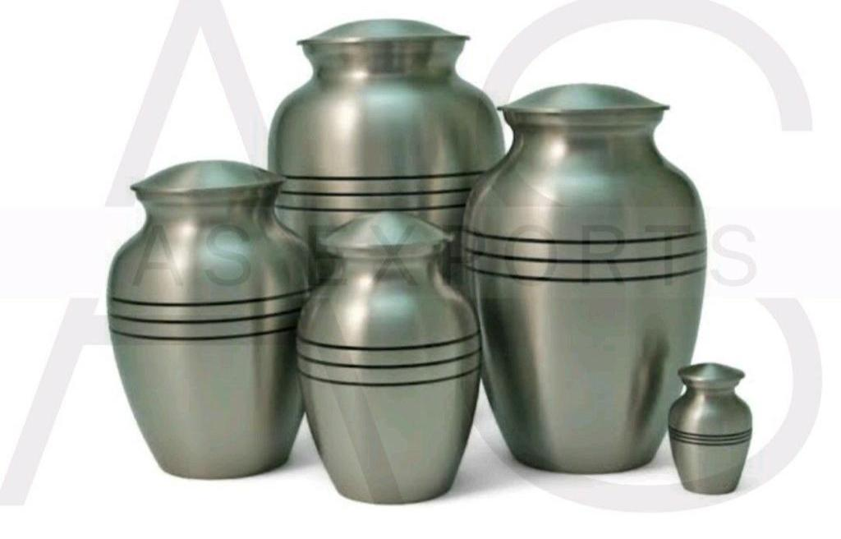
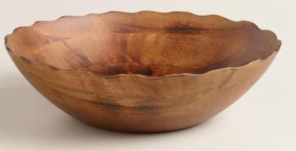
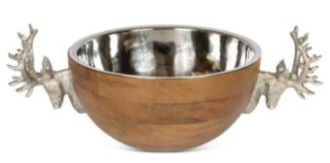
Product Showcase

Slide 9
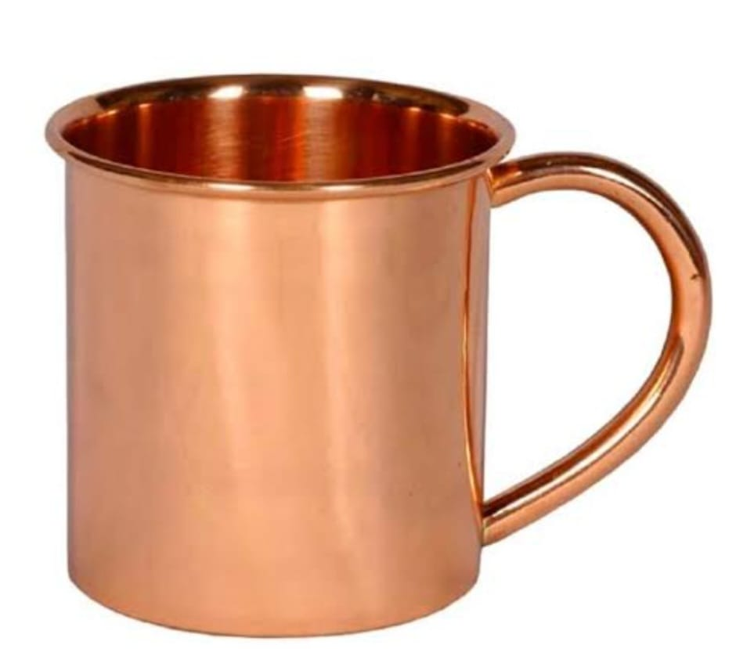
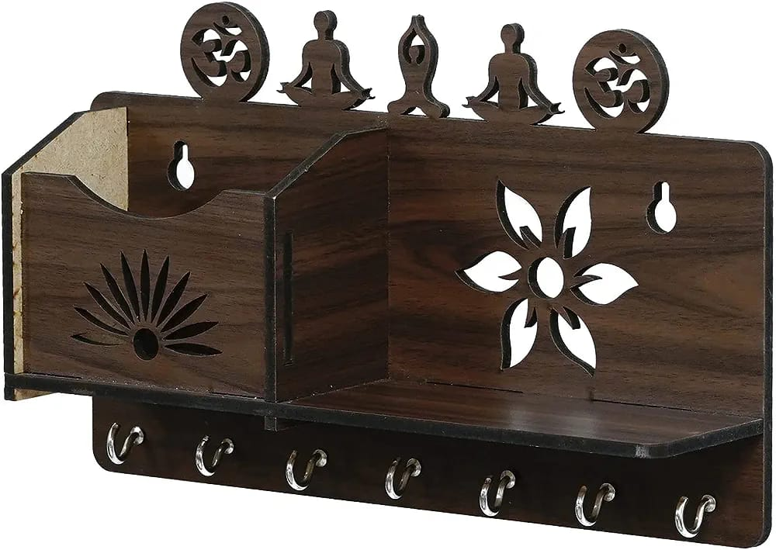
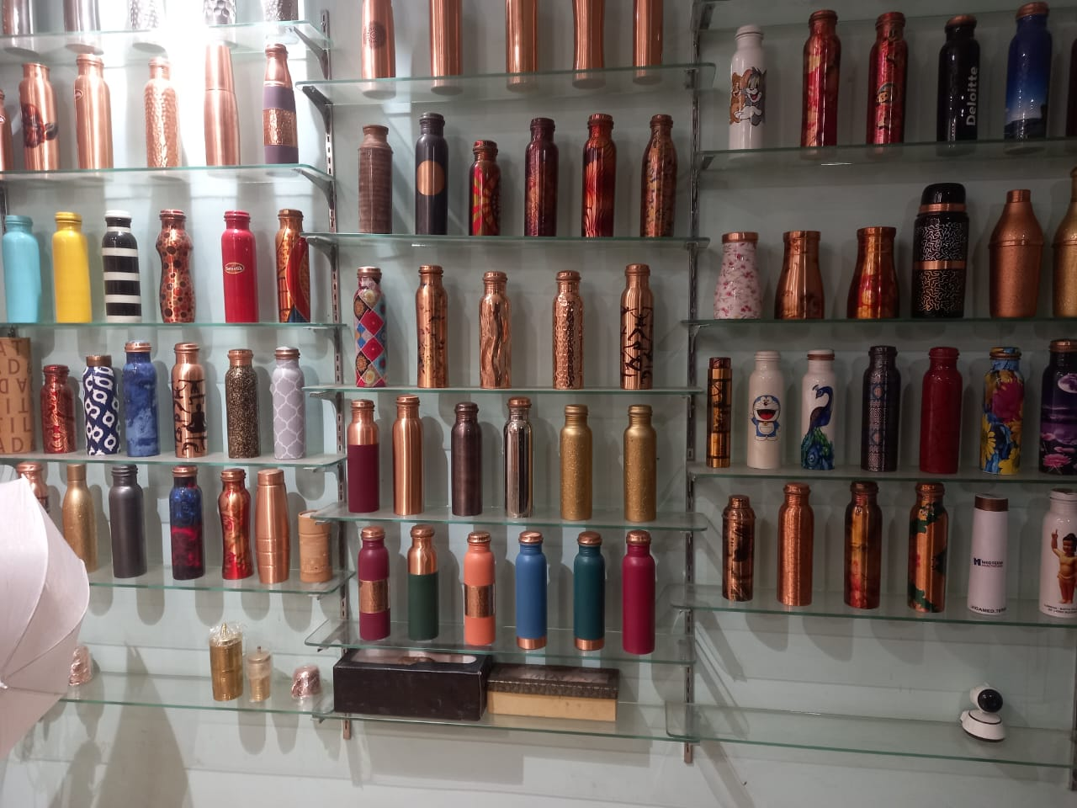
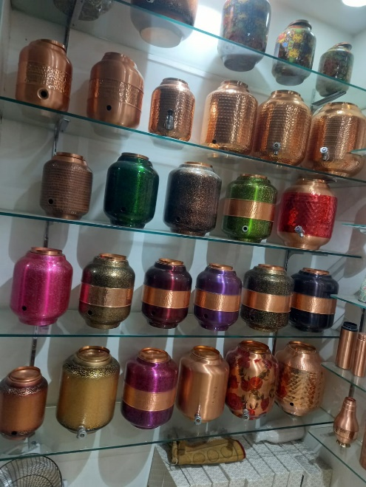
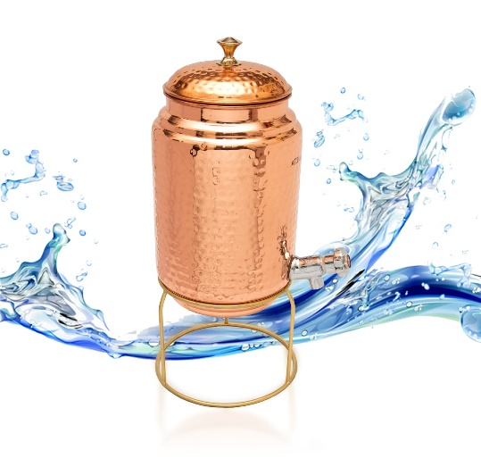
Product Showcase

Slide 10
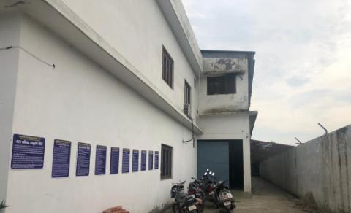
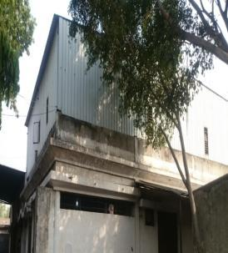
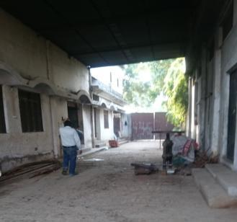
FACTORY LAYOUT

Slide 11
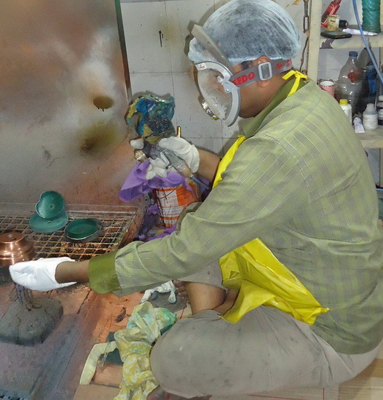
PAINT PLACE

Slide 12
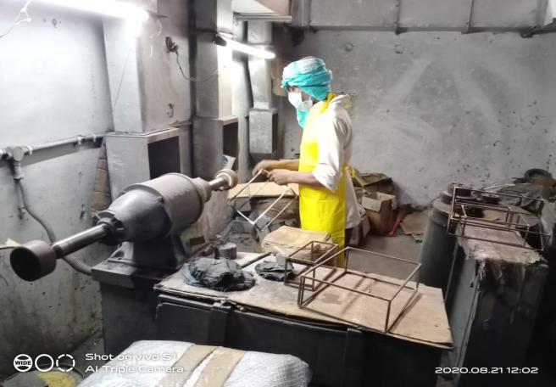
BUFFING PLACE

Slide 13
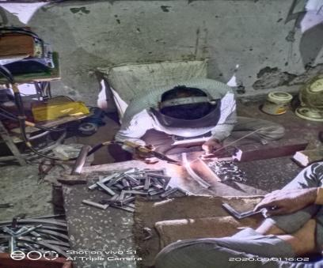
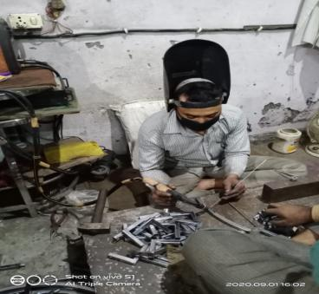
WELDING

Slide 14
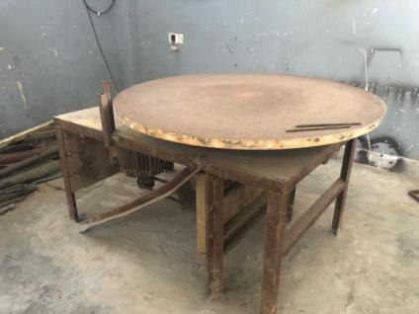
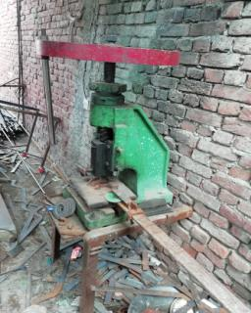
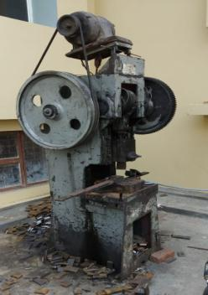
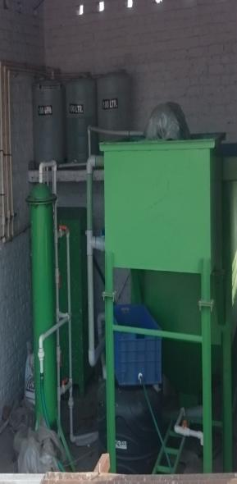
MACHINERY IN PLACE

Slide 15
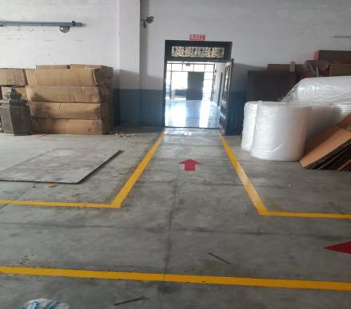
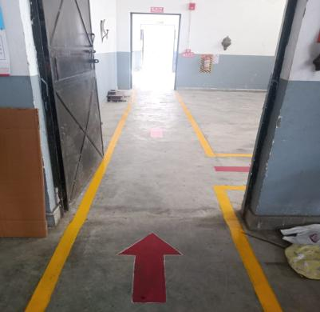
COMPANY PATHWAY

Slide 16
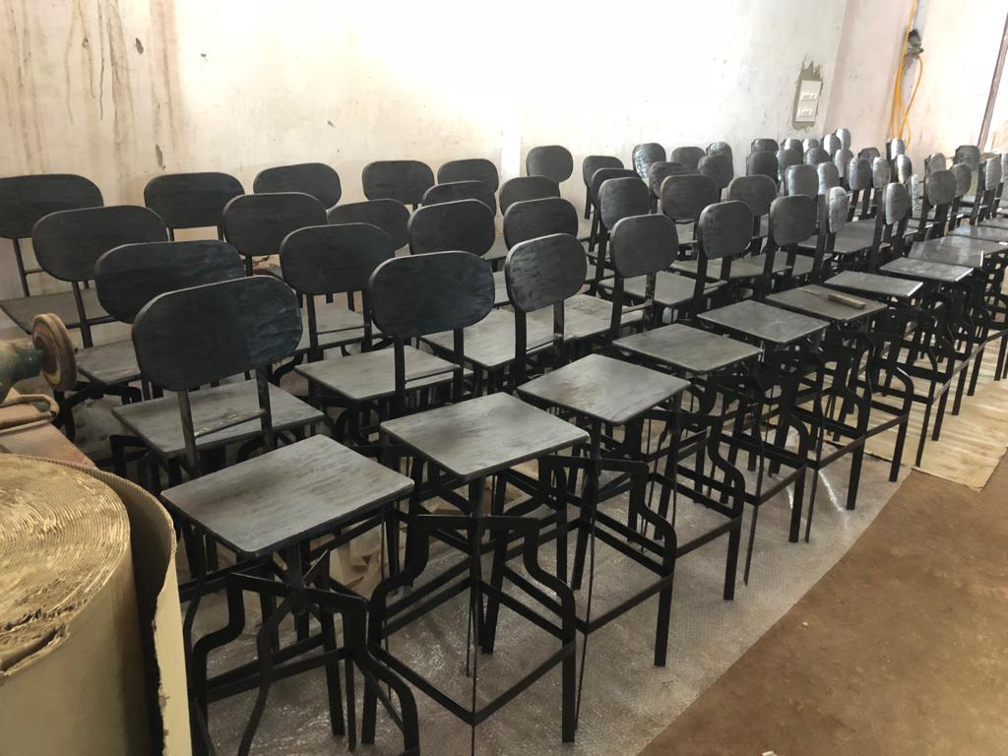
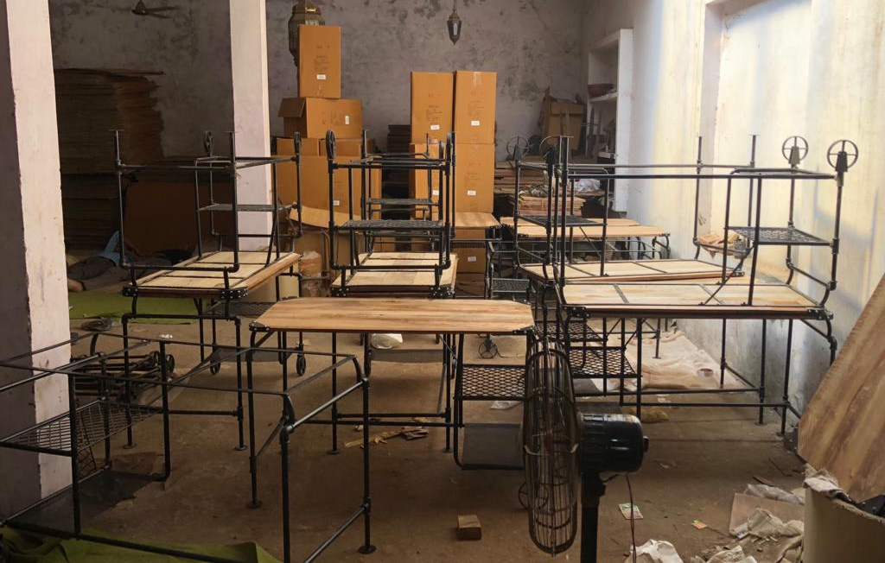
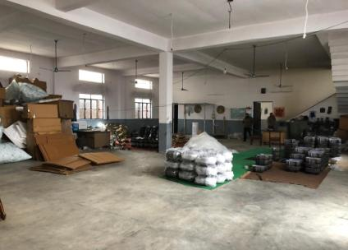
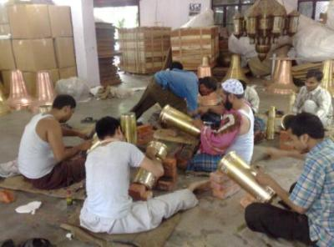
PACKAGING HALL

Slide 17
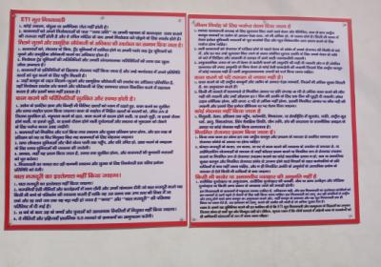
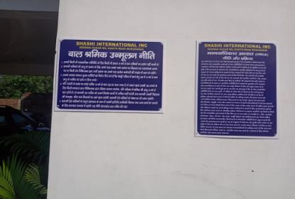
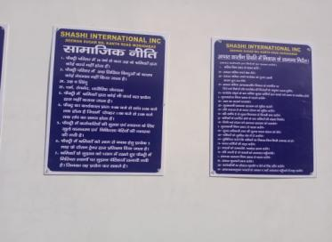
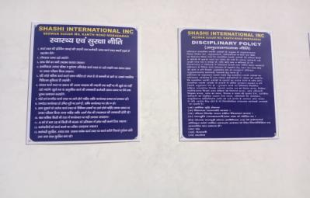
COMPANY POLICY AND BOARDS

Slide 18
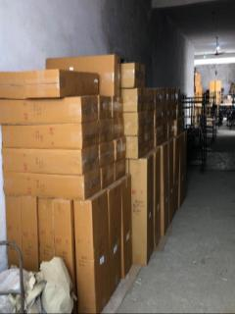
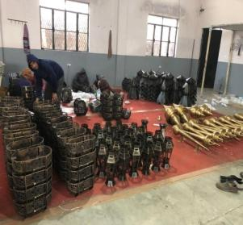
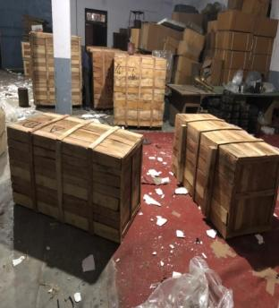
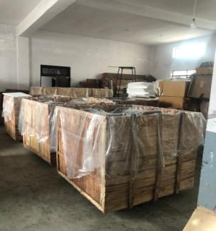
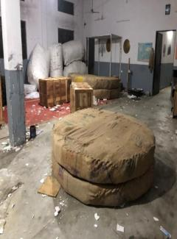
PACKAGING HALL

Slide 19



WAREHOUSE

Slide 20
STRENGTH & OPPORTUNITIES
Our Strengths lie in manufacturing products according to buyer requirements keeping our buyer’s cost in mind.
With in house or outsource facilities we are able to keep a tab on the costs hence help our customers stand out in costs in competitive markets.
With clients spread from Australia to USA and importers to retailers we have diverse experience in catering to our clients.
We have had opportunities to work for chain stores like COSTCO, Target, Laura Ashley through importers and have been catering to them at intervals.
24 hours power back through industrial feeders keep our units working without any stops.
With manufacturing at the grass root level as our promoters’ background, developmental projects are executed with ease and speed.

Slide 21
BHARAT BROTHERS OVERSEAS /QMS POLICY.
BHARAT BROTHERS OVERSEAS is committed to provide & enhance customer satisfaction (Supply defect free products, Strictly meet customer delivery schedule, Quick response to customer queries & suggestions) by supplying on consistent basis, quality handicrafts, meeting customer requirements(Ensure defect free products at each stage of production) and continually improving the effectiveness of quality management system , (Take timely and appropriate corrective actions on observed nonconformities, Identify and take actions to prevent nonconformities, Identify areas for improvement)
Mr. VIKAS SHARMA
PARTNER
+91 9927577422

Slide 22
ORGANISATION CHART
OCCUPIER
GENERAL MANAGER
H.R
SENIOR MERCHANDISER
Q.A
Q.C
SHIPPING INCHARGE
MAINTENANCE INCHARGE

Slide 23
MACHINERY / CAPACITY
S.NO MACHINE NAME QTY
1 GENSET 2
2 COMPRESSOR 2
3 DRILL AND GRINDER 6
4 WELDING SET 3
BUFFING 4
6 OVEN 2
7 FACER MACHINE 3
8 ELECTRIC PRESS 1
9 MANUAL PUNCHING MACHINE 2
10 SHEET ROLLER/CUTTERS 5

Slide 24
Thanks ! For sharing your valuable time with us.
For any further queries visit or contact
BHARAT BROTHERS OVERSEAS
HARIDWAR ROAD AGHWANPUR NEAR PAPER MILL MORADABAD – (U.P.) INDIA.
CONTACT US
MR. VIKAS SHARMA { PARTNER }
EMAIL - sharmavikas00111@gmail.com
CONT. NO. - +91 9927577422

